Slide 1
Accrual Reversals, Earnings and Stock Returns
Eric J. Allen, Chad R. Larson, Richard G. Sloan
Present by Xiaohan(Hannah) Jiang
October 8, 2018

Slide 2
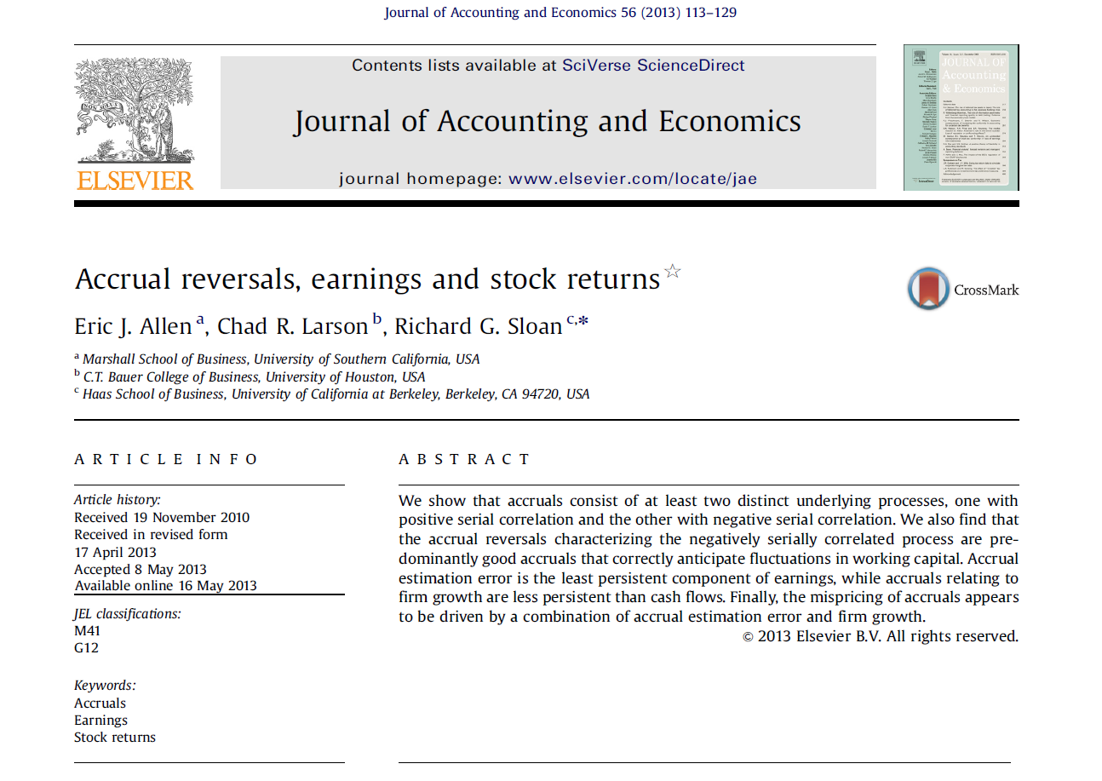

Slide 3
What is accrual and why accrual reversal is important?
An adjustment method that recognizes income when earned and expenses when incurred regardless of when cash is received or disbursed.
eg: inventory, accounts receivable, PP&E and goodwill, pension liabilities etc.
This paper: only focus on current accruals!
Will reverse when:
anticipated future benefits are realized or
new evidence indicates that benefits are unlikely to be realized.

Slide 4
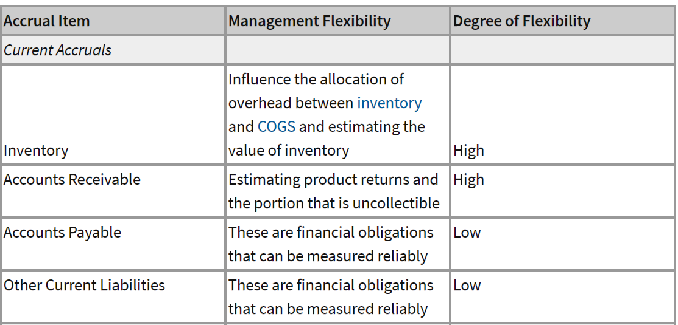
What is accrual and why accrual reversal is important?
Accrual reversals can be employed in test of earnings management.
Ending shareholders’ equity = Beginning shareholders’ equity + Net income + Other comprehensive income - Dividends declared
Read more: https://www.investopedia.com/university/accounting-earnings-quality/earnings3.asp#ixzz5THRv2ncP

Slide 5
What is accrual and why accrual reversal is important?
Accrual Anomaly (Sloan 1996):
Refers to the negative relationship between accounting accruals and subsequent stock returns.
Sloan’s paper found that shares in companies with small or negative accrual ratios vastly outperform (+10% annually) those of companies with large ones.
More on: Do Stock Prices Fully Reflect Information in Accruals and Cash Flows about Future Earnings? (Richard G. Sloan 1996)

Slide 6
Main Model and Variables Overview
Decompose accruals into three components:
Good accruals relating to firm Growth
Good accruals relating to temporary fluctuations in working capital
Accrual estimation error
Most previous research(established in Jones 1991) decompose into:
Normal accruals relating to firm growth
Abnormal accruals unrelating to firm growth
Key Distinction: involves an ex post evaluation of whether an accrual correctly anticipates a future benefits.

Slide 7
MDD Model and Variables Overview
ACC_{t} = ΔCurrent non-cash asset – Δcurrent operating liabilities
SGR_{t} = (Sales_{t}-Sales_{t-1})/Sales_{t-1}
EMPGR_{t} = (Employees_{t}-Employees_{t-1})/Employees_{t-1}
CF = Income – Accruals
All the financial variables in sample are scaled by average total assets.
MDD: proposed by Dechow and Dichev(2002),modified by Bushman et al.(2011)

Slide 8
Three Empirical Predictions
P1: ‘Good’ accruals consist of two distinct processes.
One positively serially correlated process representing persistence in firm growth.
One negatively serially correlated process representing temporary fluctuations in working capital.
P2: The lower persistence of accrual component of earnings is attributable to accrual estimation error.
P3: The negative relation between accruals and future stock returns is attributable to accrual estimation error.

Slide 9
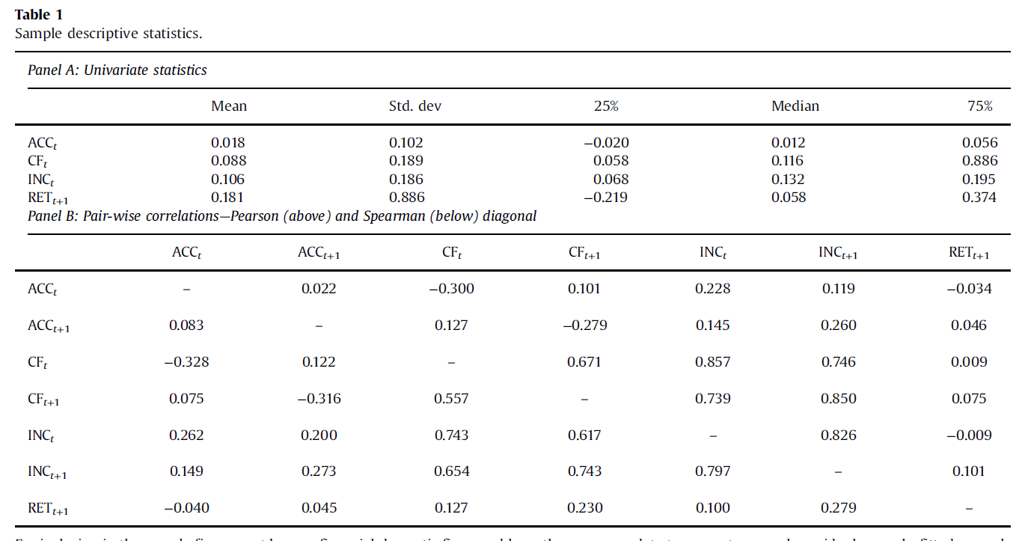
P1: Good accruals consist of two distinct processes:

Slide 10
P1: Good accruals consist of two distinct processes:
Table1：
ACC displays weak positive serial correlation, CF and INC display strong positive serial correlation.
Negative correlation between ACC_{t} and CF_{t} is consistent with ‘good accruals that offset the impact of temporary fluctuations in working capital on cash flows.
ACC_{t} negatively correlated with RET_{t+1} ——well known ‘accrual anomaly’.

Slide 11
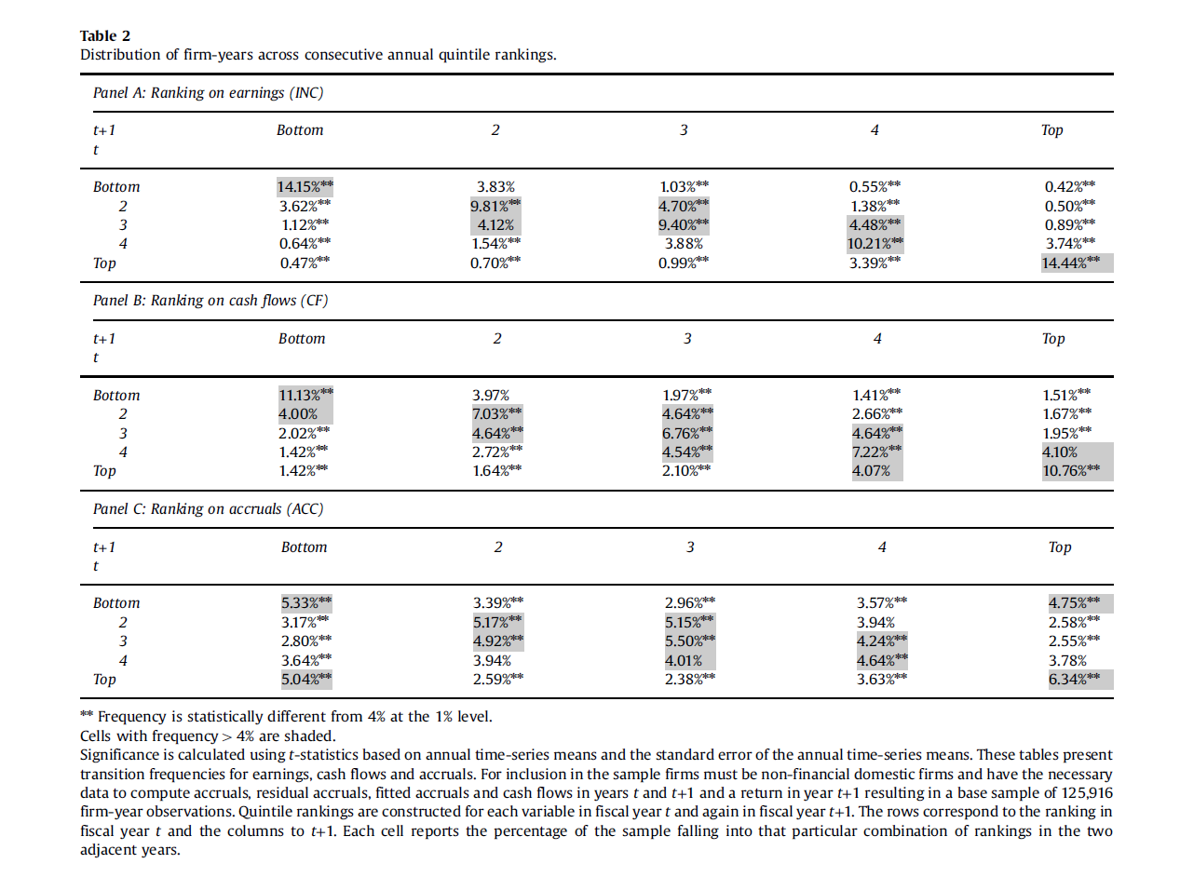
P1: Good accruals consist of two distinct processes:

Slide 12
P1: Good accruals consist of two distinct processes:
Table 2:
Quintile portfolio transition matrices between current year and subsequent year.
If there is no serial correlation or temporal dependency, each cell will be exactly
4%.
Simple positive serial correlation leads to greater proportion fall in/around main diagonal cells, while negative correlation leads to fall in minor diagonal cells.

Slide 13
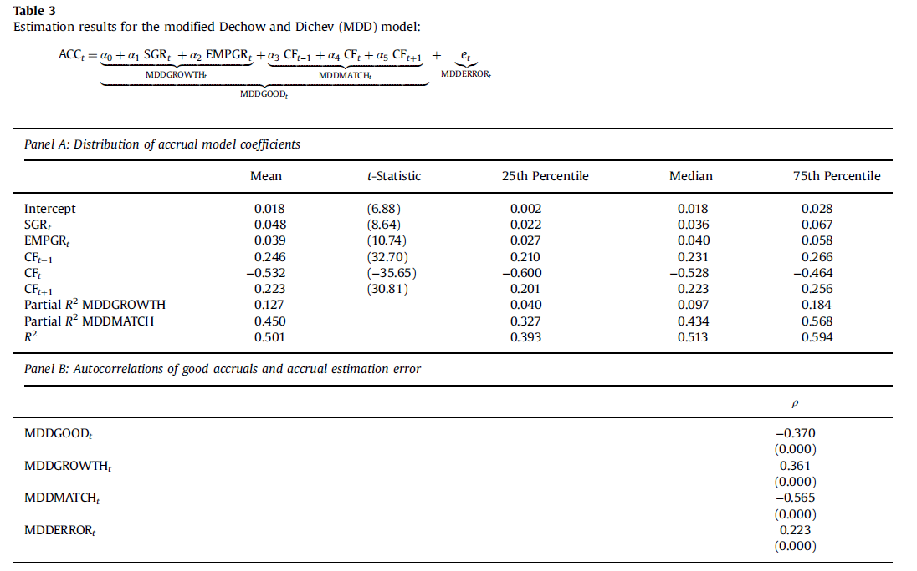
P1: Good accruals consist of two distinct processes:

Slide 14
P1: Good accruals consist of two distinct processes:
Table 3:
Panel A: Partial R-squares for MDDMATCH(0.45) is greater than MDDGROWTH(0.127), R-squares for MDDGOOD is 0.5
Temporary fluctuation component is more economically significant that growth component.
MDD model does a reasonably good job at explaining variation in accruals.
Panel B: Good accruals(MDDGOOD) : negative serial correlation(-0.37)
MDDGROWTH(-0.565) contributes most to MDDGOOD negative sign.
MDDMATCH(0.361),positive. Prediction 1 verified again.
MDDEROOR(0.223) is positively serially correlated!
Error take longer than one period to reverse or
Positive correlated good accruals are misclassified as estimation error

Slide 15
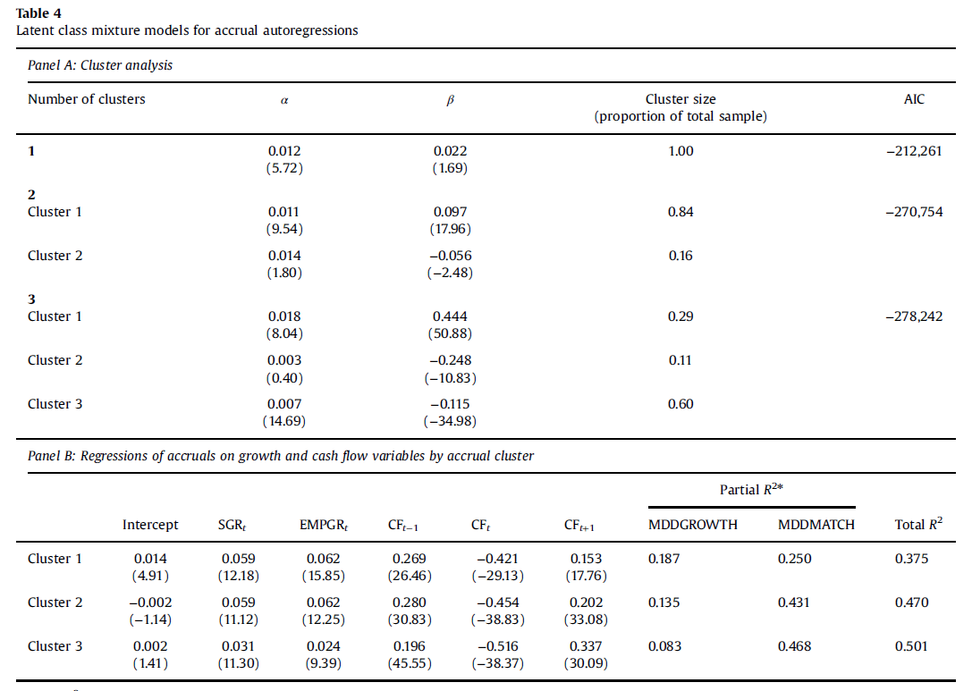
P1: Good accruals consist of two distinct processes:
Time-series properties of accruals:

Slide 16
P1: Good accruals consist of two distinct processes:
Panel A: Latent class mixture models
Expect to observe at least 2 distinct clusters in accrual autoregressions if prediction one is true.
Coefficients diverse as adding more clusters
Panel B: Relate each cluster to hypothesized economic determinants
Cluster 1 should have strongest relation to MDDGROWTH
Partial R-square for MDDGROWTH is the largest.
Cluster 2&3 should have stronger relations with MDDMATCH
Partial R-squares are larger.

Slide 17
P2: The lower persistence of accrual component of earnings is attributable to accrual estimation error.
Lower persistence of accrual:
Firm with higher accruals tends to be less profitable in the future.
This link between accruals and future profitability, is often characterized by saying that accruals are ‘less persistent’ than cash flows

Slide 18
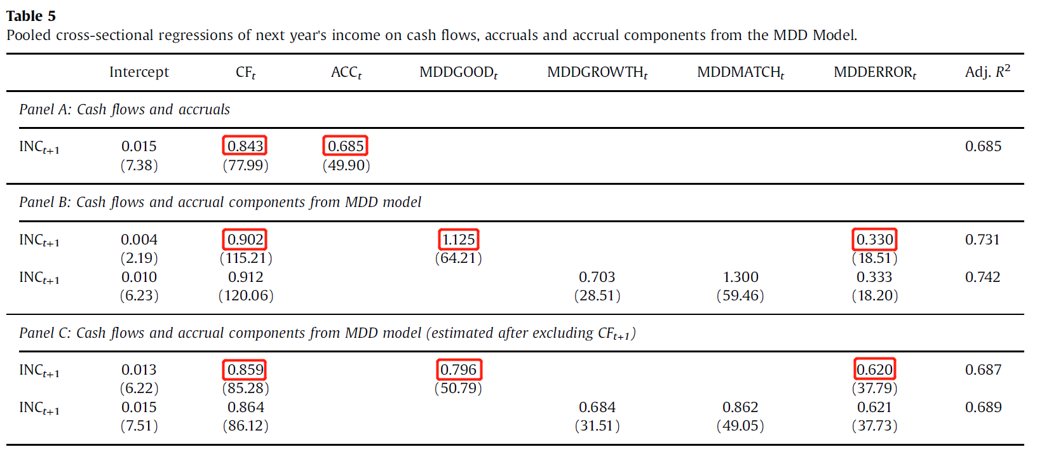
P2: The lower persistence of accrual component of earnings is attributable to accrual estimation error.

Slide 19
P2: The lower persistence of accrual component of earnings is attributable to accrual estimation error.
Table 5 results:
Panel A: the coefficient on ACC_{t} (0.685) is lower than the coefficient on CF_{t} (0.843).
Lower persistence.
Panel B: The coefficient on MDDERROR_{t} is 0.330 while the coefficients on CF_{t} and MDDGOOD_{t} are 0.902 and 1.125 respectively.
Lower persistence attributable to estimation error.
Panel C: Omit CF_{t+1} to deal with mechanical positive correlation between MDDMATCH_{t} and INC_{t+1}
Note MDDMATCH do not contribute to the power persistence!

Slide 20
P3: The negative relation between accruals and future stock returns is attributable to accrual estimation error.

Slide 21
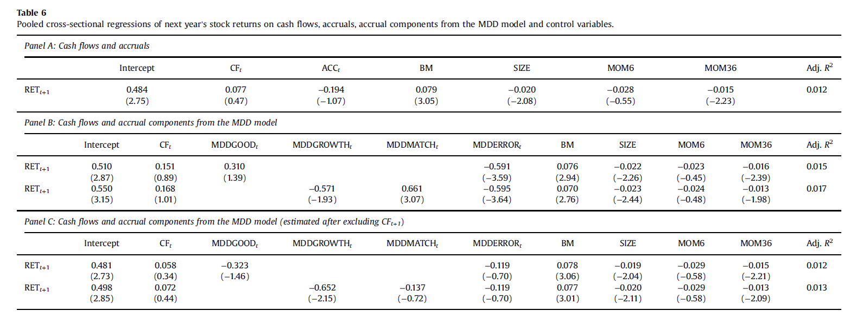

Slide 22
P3: The negative relation between accruals and future stock returns is attributable to accrual estimation error.
Table 6 results:
Panel A: Accrual anomaly, while it is statistically insignificant because of the design of the model.
Panel B: Negative relation between accruals and future stock returns is primarily attributable to MDDERROR.
Prediction 3
Panel C: Omit CF_{t+1,} to decompose accruals.

Slide 23
Inventory Write-Down Results
Inventory write-downs represent reversals of prior positive accrual estimation errors.
If the MDD models is successful at isolating accrual estimation errors and their subsequent reversals, we expect to find relation:
 | The Year of write-down | The year before write down
Corr(MDDERROR, write-downs) | Positive | Negative

Slide 24
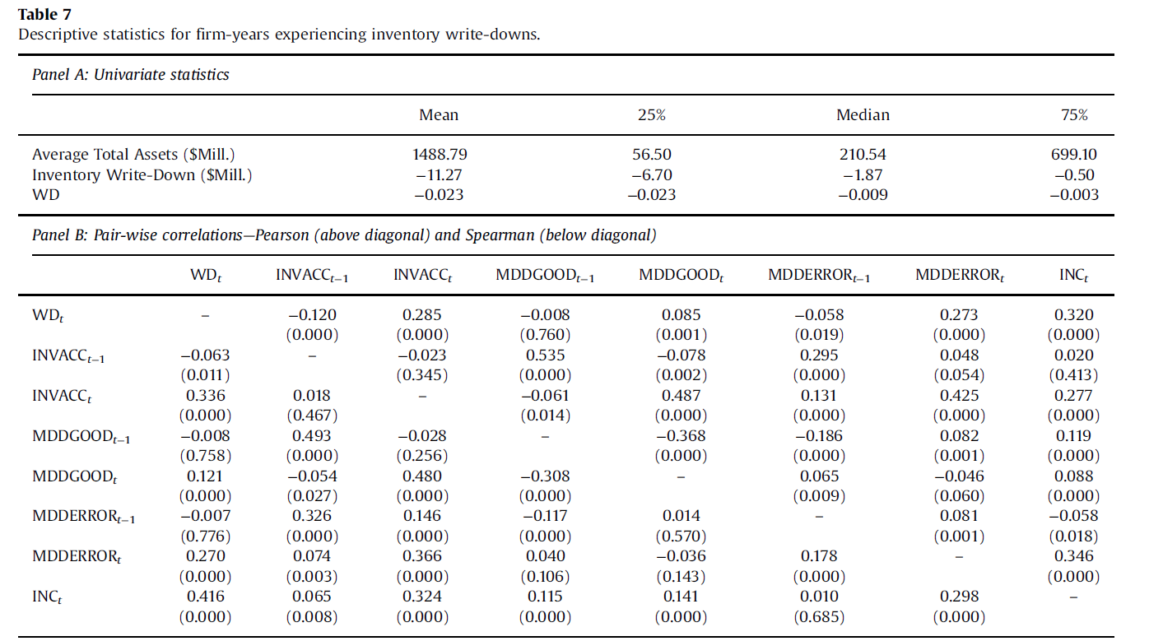
Inventory Write-Down Results

Slide 25
Conclusions
Accruals consist of two distinct process, a persistent process that reflects firm growth, and a reversing process that reflects temporary fluctuations in working capital.
Most accrual reversals represent ‘good’ accruals that correctly anticipate temporary fluctuations in working capital
Accrual estimation error is the least persistent component of earnings

Slide 26
Why the findings are important?
Previous research has modeled accruals as consisting of a single white noise process.
Incorrect! They consist of at least two distinct processes. Researchers have overlooked important economic characteristics of accounting data.
Findings have implication for earnings management
The lower persistence of accrual component of earnings and associated mispricing appear to be driven by accrual estimation error and firm growth
Identifies puzzles and opportunities for additional research
Unable to document systematic evidence of adjacent year reversals in firm level estimation errors.

Slide 27
Remarks
The paper did a good job in showing that accruals consist of two distinct processes. It is a good explanation model overall.
Concern about their methods of bringing future cash flow into their models. After excluding CF_{t+1} , some explanations are vague to me.
A little bit disappointing that it has little to do with trading strategy.
Would be more happier if author can shed more light on earnings management.

Slide 28
Thanks!

